Slide 1

Machine Learning Group Project Presentation - Restaurant star rating prediction
Created using Yelp data
Sio Kei Chang, Oluwayomi Oluwaniyi Amodu
¹ School of Computing, Dublin City University, Ireland

Slide 2
Group member’s contribution
Sio Chang:
Modelling
Data exploratory
SQLite
Data Conversion
Oluwayomi Amodu:
SQLite
Data exploratory
Modelling

Slide 3
Objective
Using data downloaded from Yelp
To predict if a user would give a review greater than the restaurant' average star rating.

Slide 4



What is the Yelp dataset?
Yelp Dataset
The Yelp dataset is a portion of Yelp's listings, reviews, and user information for use in private, academic, and educational contexts. available as JSON files online.
Some Attributes:
Hours Open
Parking
Noise level
Delivery
Available files (Used Files):
user.json
business.json
reviews.json
tip.json
checkin.json

Slide 5
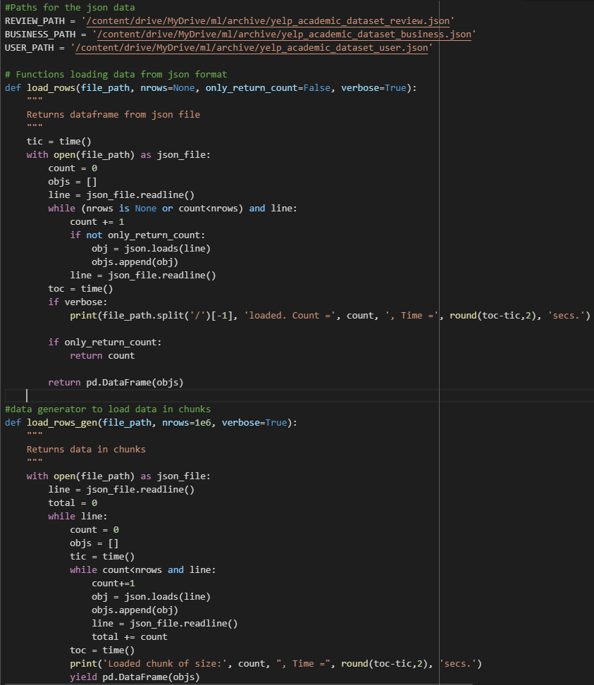


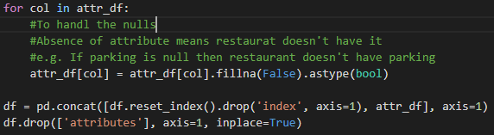
SQLite db
Handling the Yelp dataset
Size:
113.4 MB
business.json
Size:
3.13 GB
user.json
Code used to load in “.json” files, and upload the altered files to a sql database
yelp_database.db
Size:
4.98 GB
Size: 3.62 GB
reviews.json
Null value handling

Slide 6
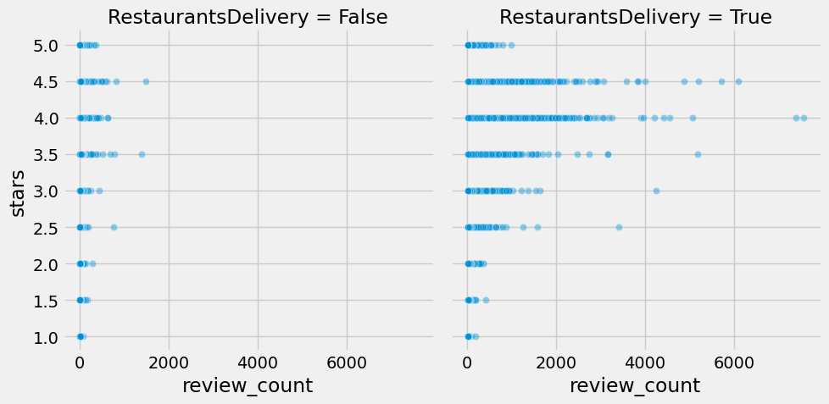
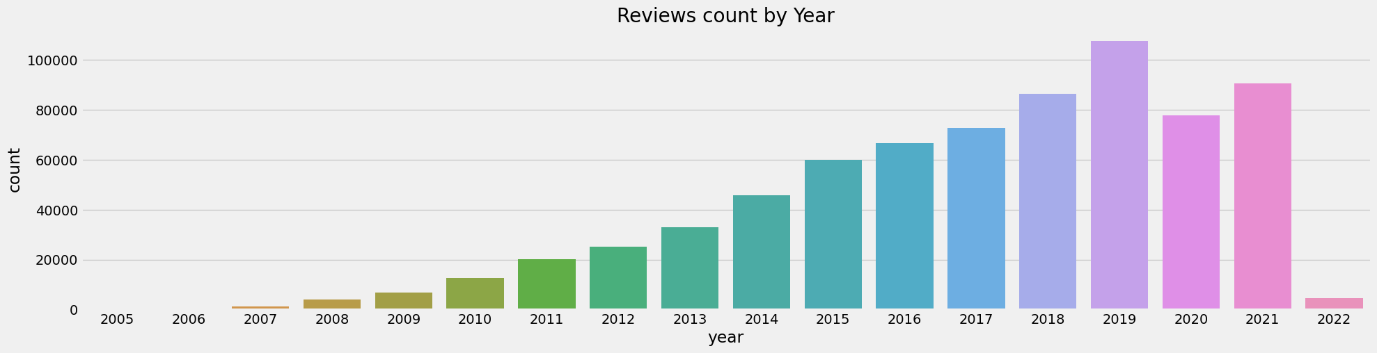
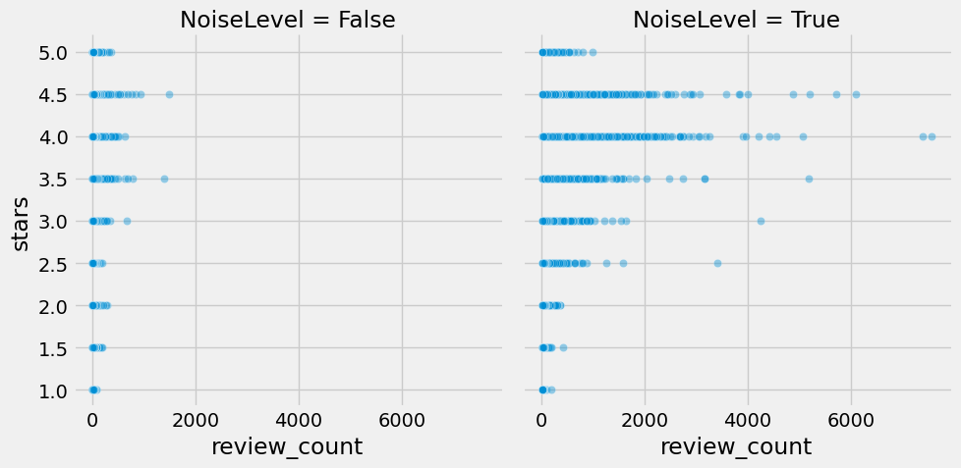
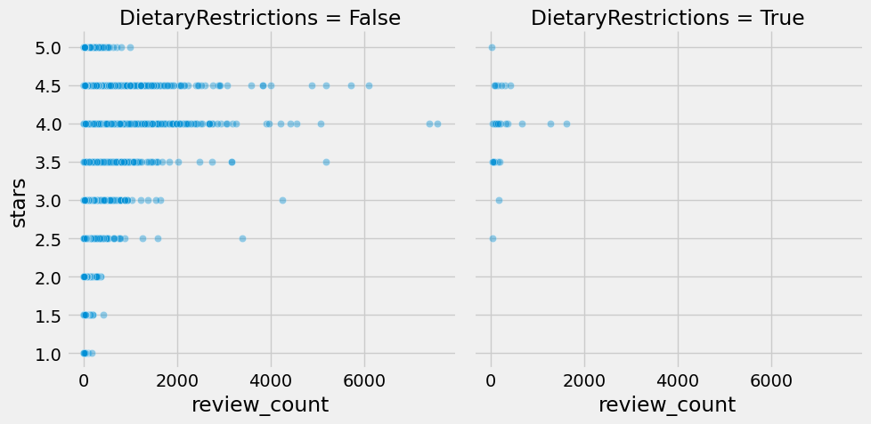
Understanding the Yelp data
Notes:
Yelp's number of reviews in each year keep going up until 2020 where we see a sudden drop of reviews, but the number of reviews have started to increase back up in 2021.

Slide 7
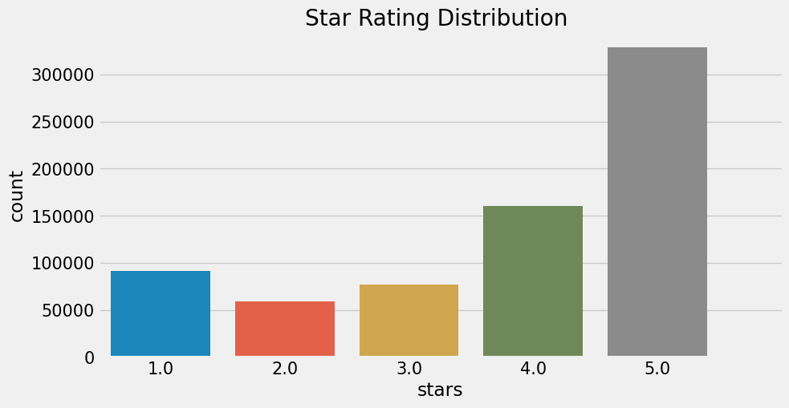
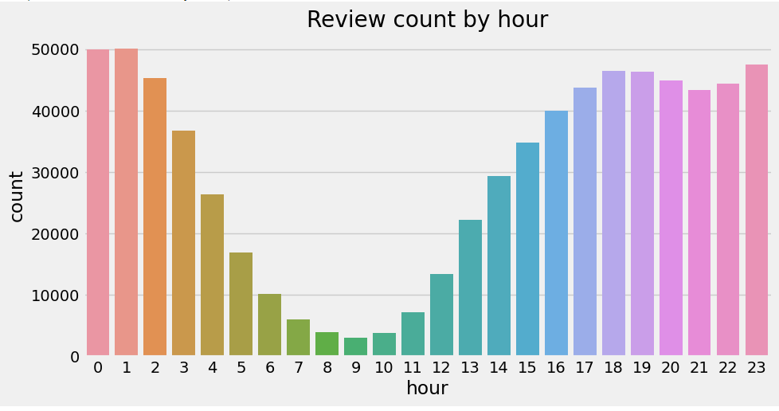
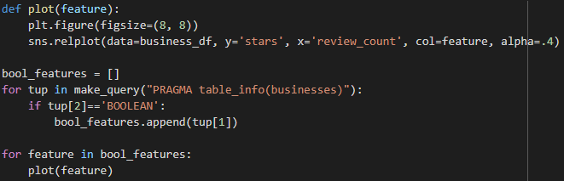
Understanding the Yelp data
A lot of the ratings are in 4 or 5 stars
Reviews given per hour

Slide 8
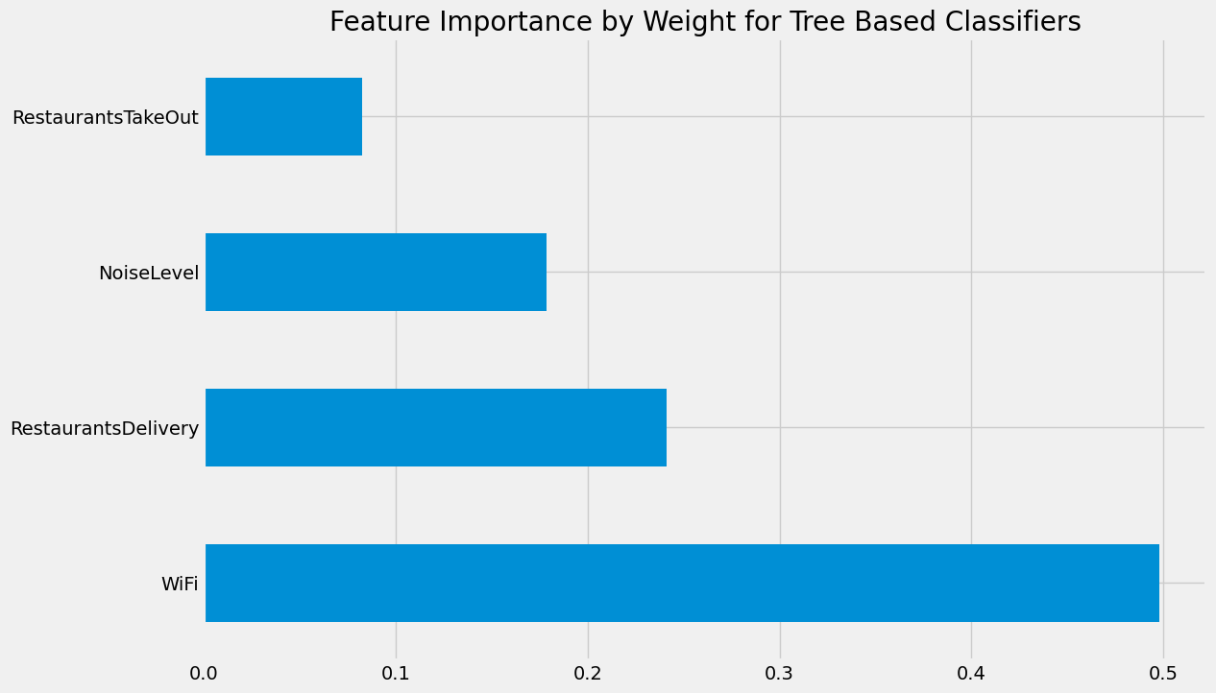
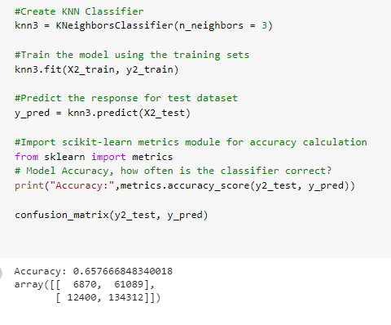


Evaluation metrics
ADAboost Classifier model

Slide 9
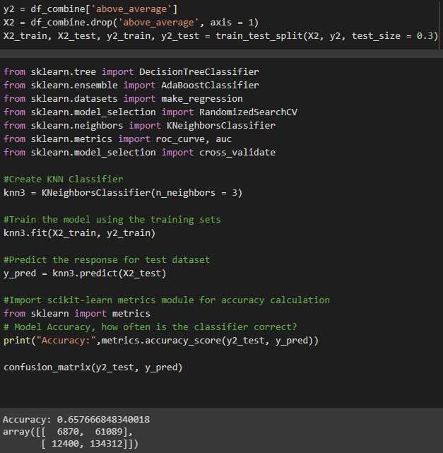
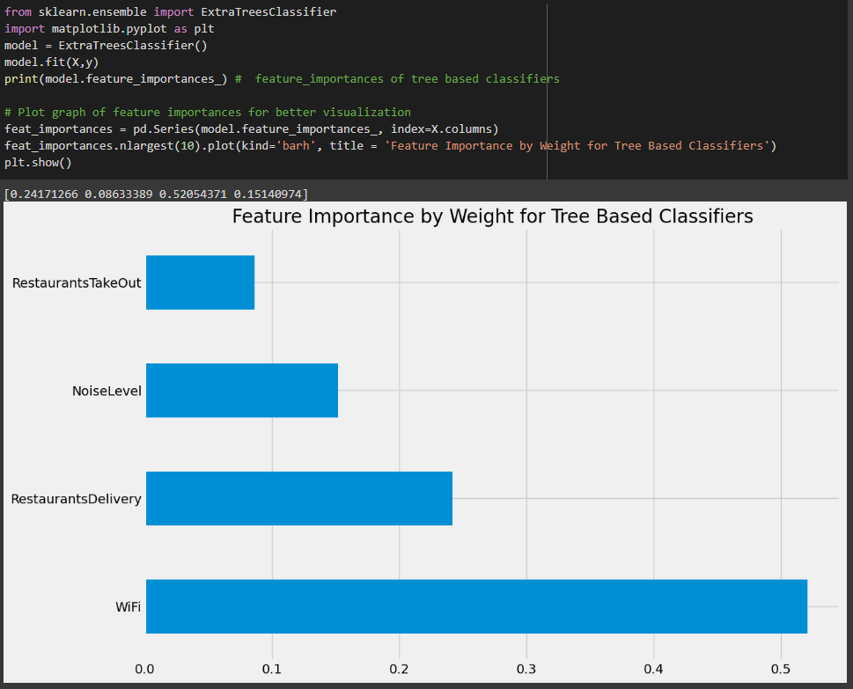
Introduction of algorithms
KNeighbors
ExtraTreesClassifier

Slide 10
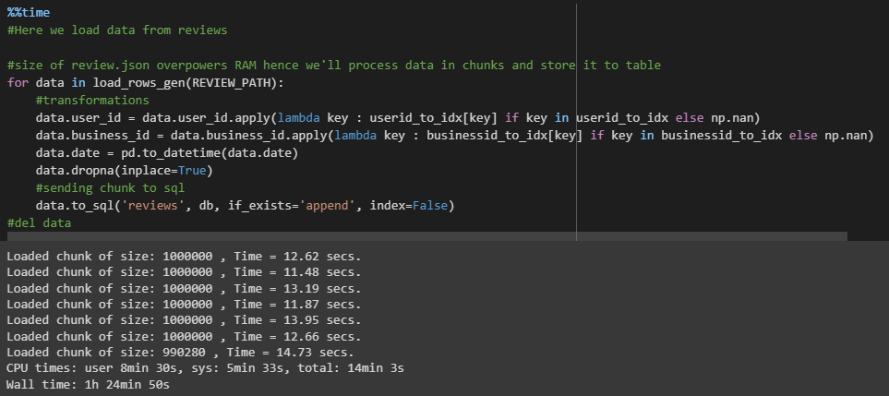
Challenges and Solutions:
Challenges:
1. Uploading the 10gb files to google drive
Runtime errors
DCU library internet was too slow
Average time to upload all files is above one hour
Solutions:
Obtaining a stable internet connection, over a wired source
Challenges:
2. Compiling the “.json” files using SQLite
Time out during sessions
The cell took 80 minutes to complete
Google colab struggled with resources(Ram)
Solutions:
Obtaining a stable internet connection, over a wired source
Purchasing Colab Pro, to take advantage of the extra ram and processing power(Ram size: 12.3gb -> 25gb )

Slide 11


